Slide 1
Presentation
Martin Pernollet

Slide 2
Summary
Education
Web edition experiences
Offline software experiences
Some personal projects
Motivation for bioinformatic

Slide 3
Education
Multimedia diploma at IUT de Velizy
Master in software engineering at EFREI
  Last semester at Helsinki University of Technology

Slide 4
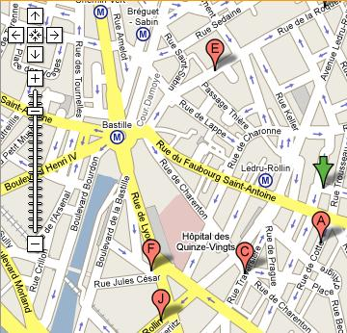
Web edition experiences (1/3)
Geographical « shop finder » on 3 millions of french shop for Vialys.fr
Microsoft ASP
Access
Visual Basic

Slide 5
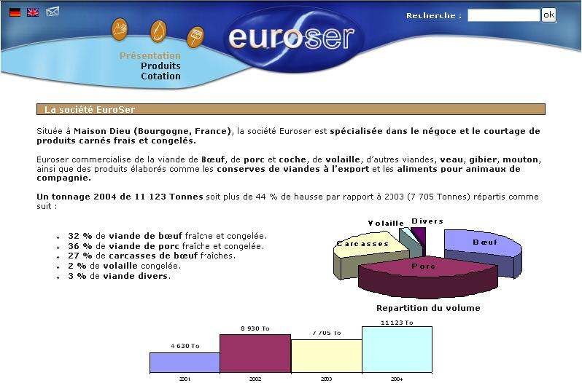

Web edition experiences (2/3)
Graphics and animation of two websites
Photoshop
Flash
PHP

Slide 6
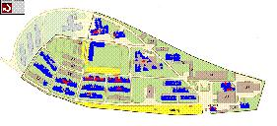
Web edition experiences (3/3)
Development of an optimizer for reorganizing workspace affectations for INRIA (Consensus).
C++ CGI on Apache server (UNIX)
Genetic algorithm for modifying user preferences

Slide 7
Offline software experiences (1/6)
A three years experience at MASA
Team composition

Slide 8
Offline software experiences (2/6)
Machine learning for factory processes enhancement
  Regression
  Density Estimation
  Classification
  Frequent Item Sets

Slide 9
Offline software experiences (3/6)
Core work
Matlab
Prototype
Concept
Toolbox
Algorithms (SVM, PCA, Parzen, etc)
C++

Slide 10
Offline software experiences (3/6)
Core work
Java
Matlab
Application
Prototype
Plugin
Concept
Toolbox
Engine
C++
Algorithms (SVM, PCA, Parzen, etc)

Slide 11
Offline software experiences (3/6)
Core work
Java
Matlab
Application
Graphic libs
Prototype
Plugin
Concept
Toolbox
Engine
C++
Algorithms (SVM, PCA, Parzen, etc)

Slide 12
Offline software experiences (4/6)
Other tasks
  Software protection
  Software packaging

Slide 13
Offline software experiences (5/6)
Tools
  Versioning (subversion)
  Continuous integration (cruise control)
  Bugtracking (mantis)
  Test procedure (boost::test)

Slide 14
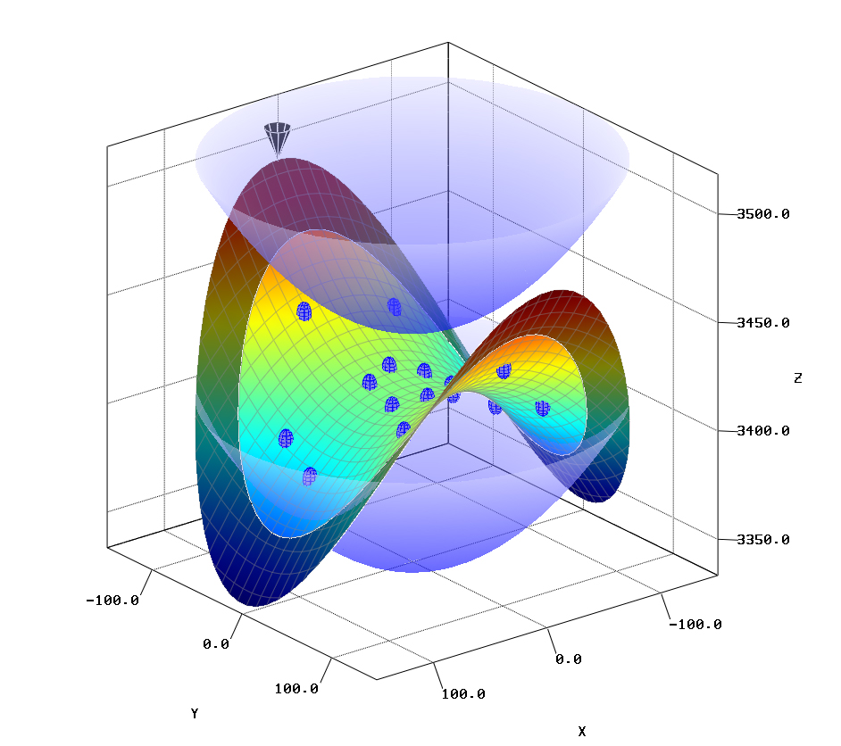
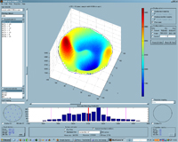
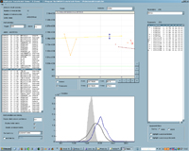
Offline software experiences (6/6)
Screenshots

Slide 15
Some personal projects
Text classifier for a money manager
Piano score classification system
Simulated bacteria colony
Image learning & recognition system

Slide 16
Text classifier (1/5)
Feasability study of a web money manager
Concept:
  The user tags transactions by setting them into a category
  An algorithm extract relevant words from text labels in classified transaction, in order to automatically classify future transactions

Slide 17
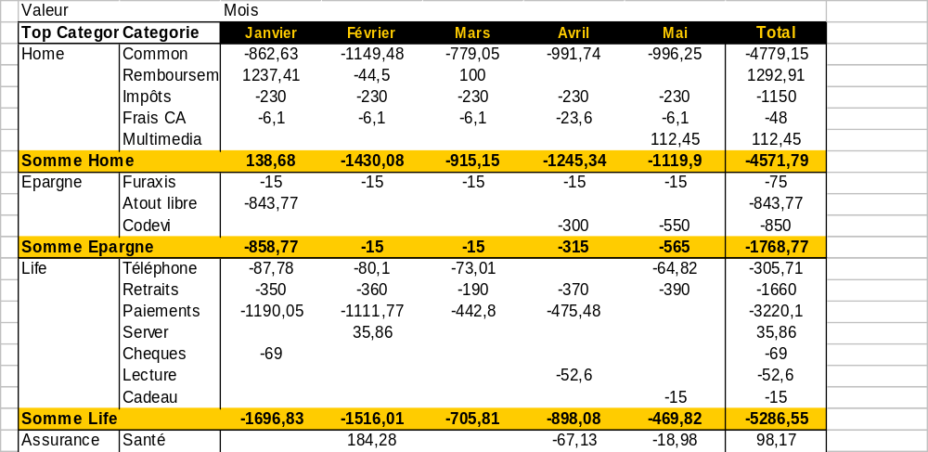
Text classifier (2/5)
Result is a self-maintained accounting with tree-like categories (requires 3 month training)

Slide 18
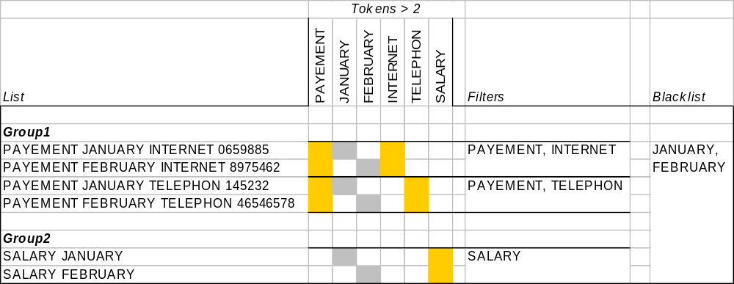
Text classifier (3/5)
Learning consists in retrieving relevant keywords (i.e. filters) for a category

Slide 19
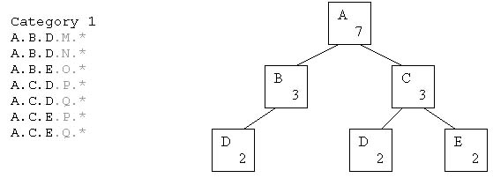
Text classifier (4/5)
A Closed Item Sets algorithm detects most frequent and precise (i.e. complex) patterns

Slide 20
Text classifier (5/5)
Good « early » algorithm
Nice prototype interface on Ruby/Ajax
Too complex from a business point of view

Slide 21
Piano score classification system (1/8)
Goal: define a similarity measure between (MIDI) piano scores
Application:
  Train a model using N Chopin songs
  Train a model using N Bach songs
  Guess if a new song is closer to Bach or Chopin

Slide 22
Piano score classification system (2/8)
MidiFile 1
Fragment 1
Fragment 2
Fragment f
Preprocessing
Transpose
TrimSilence
LengthReduction
Poly2mono
Feature
PCD (12D)
PJD (25D)
DCD ((T/R)D)
NN (1D)
PCD 1
PCD 2
PCD f
Parzen Density Estimatrion
PCD Density
MidiFile 1
PCD Density
MidiFile 2
Entropy Kernel
Similarity measure

Slide 23
Piano score classification system (3/8)
Descriptor 1: Pitch class distribution
  Frequency of each note (C, C#, D, …)
  12 notes -> 12 dimensions
  Describe harmonic state of a fragment

Slide 24
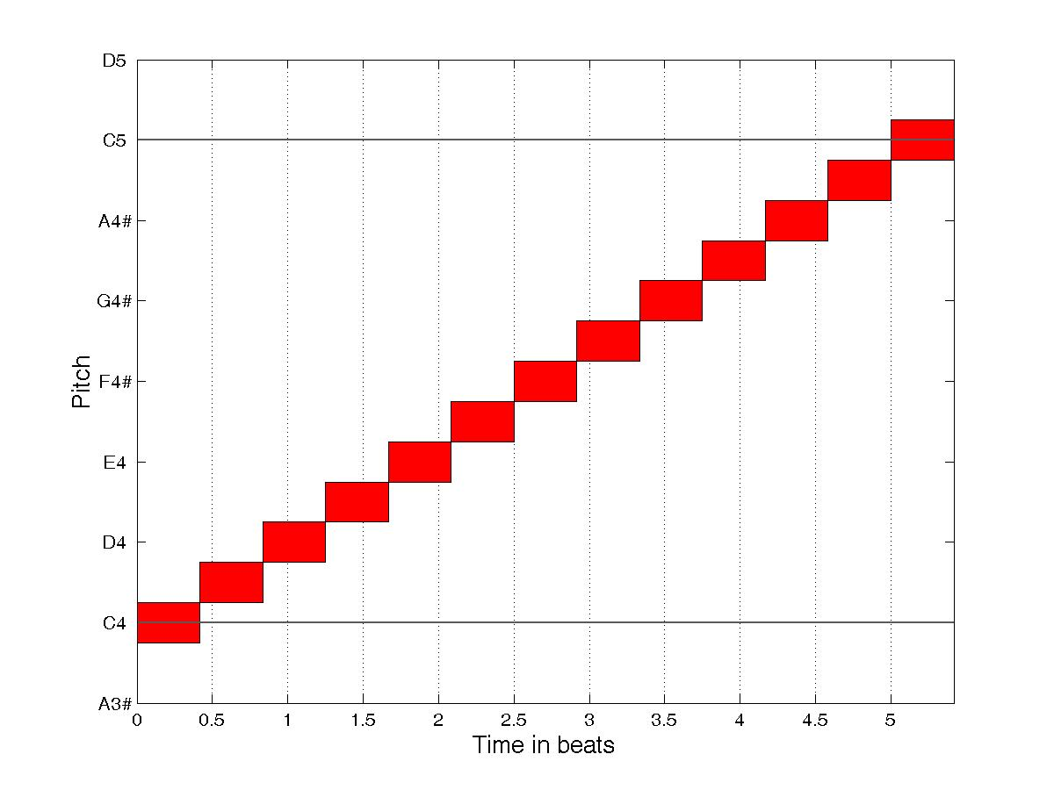
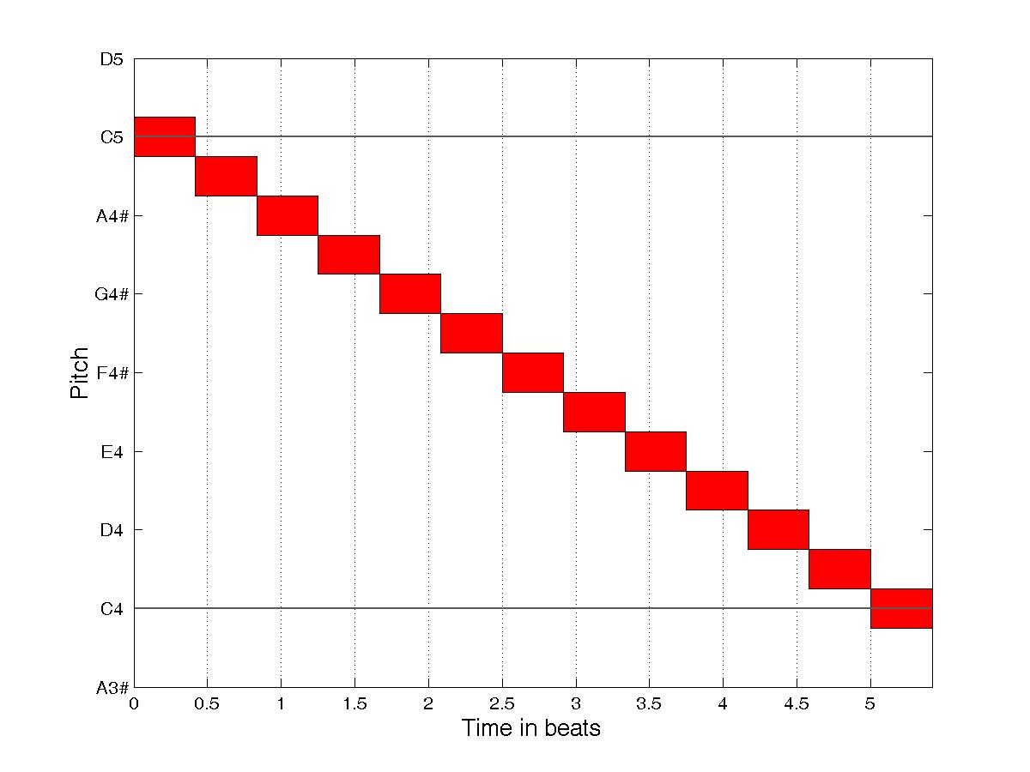
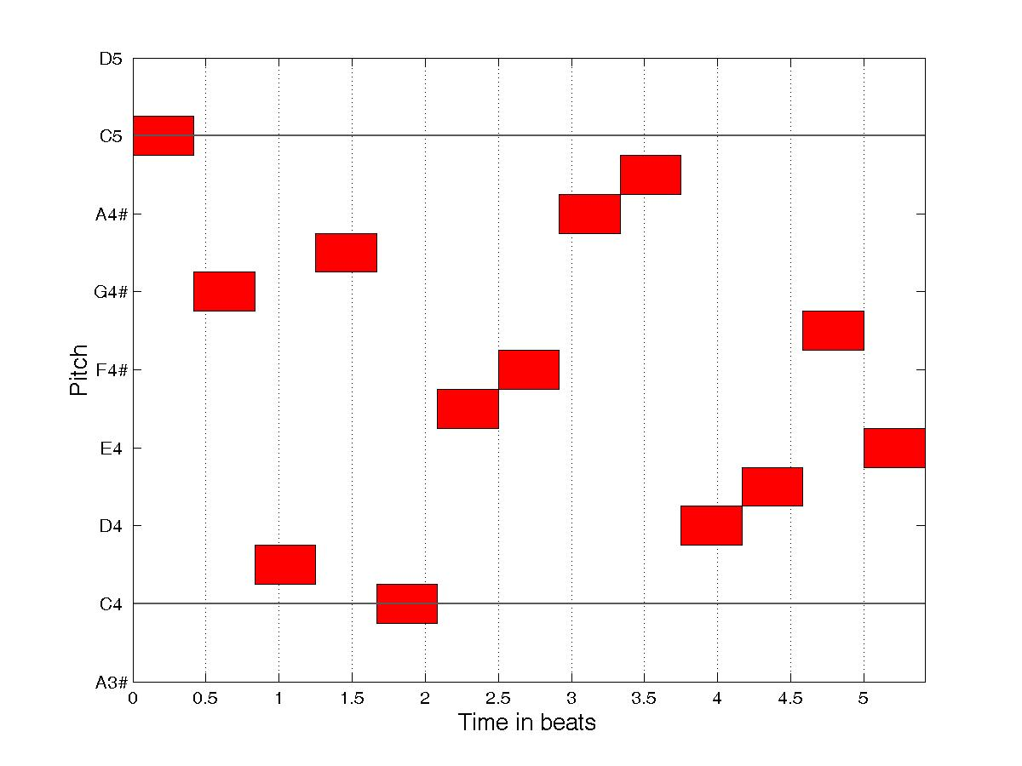
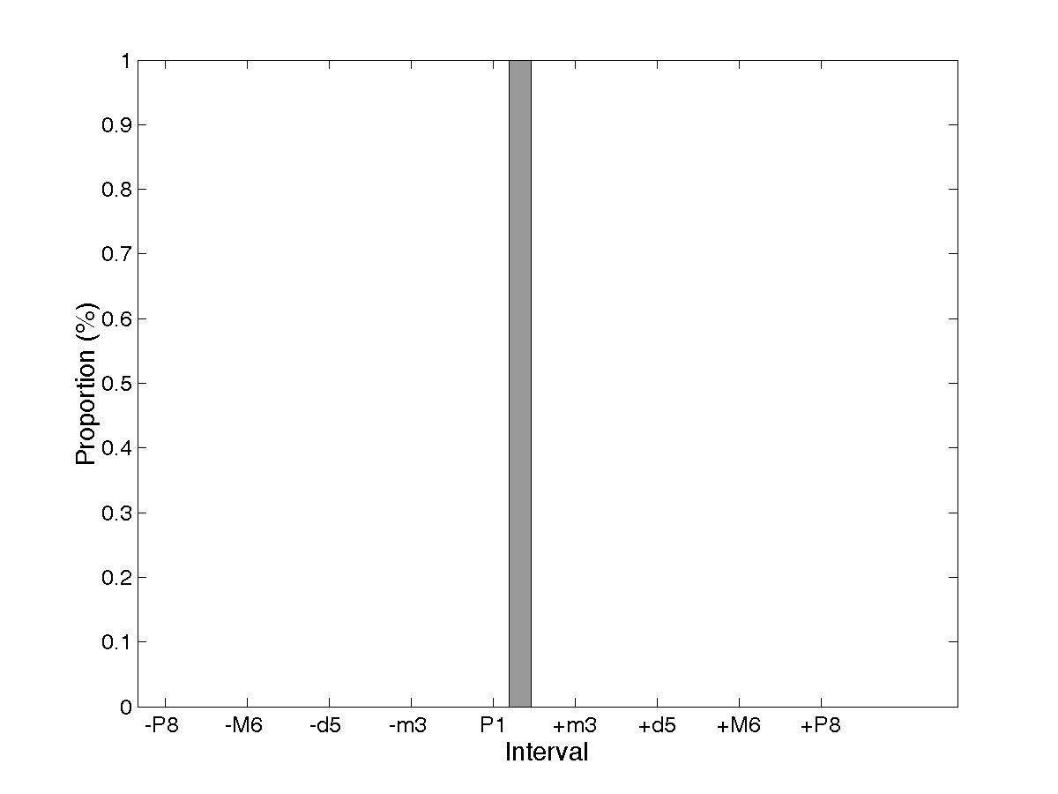
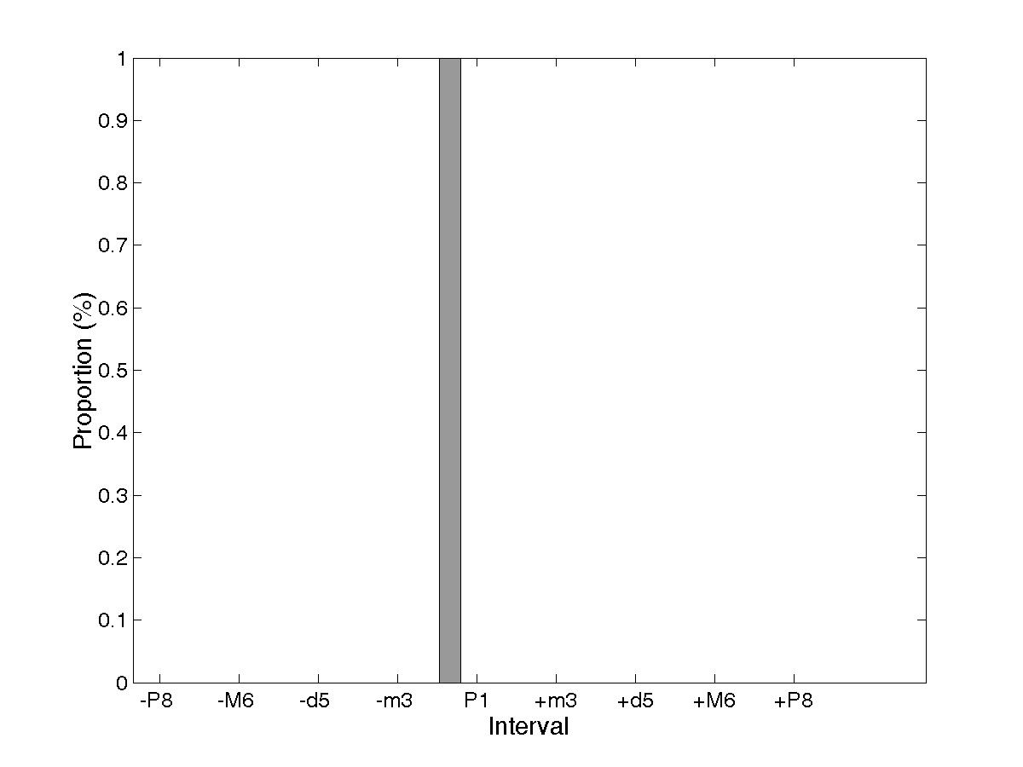
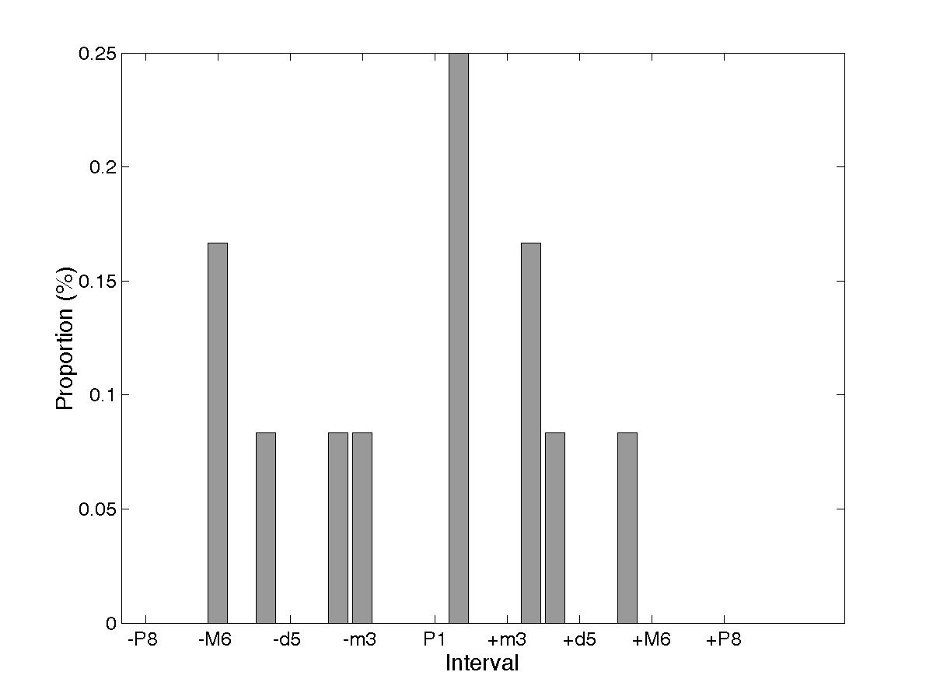
Piano score classification system (4/8)
Descriptor 2: Pitch jump distribution
  Note distance (e.g: C-C#=1, D-C=-2)
  Possible offsets: 12 up, 12 down and 0
  Describe melodic complexity of a fragment
Red: same notes
in various orders
Gray: note gaps
distribution

Slide 25
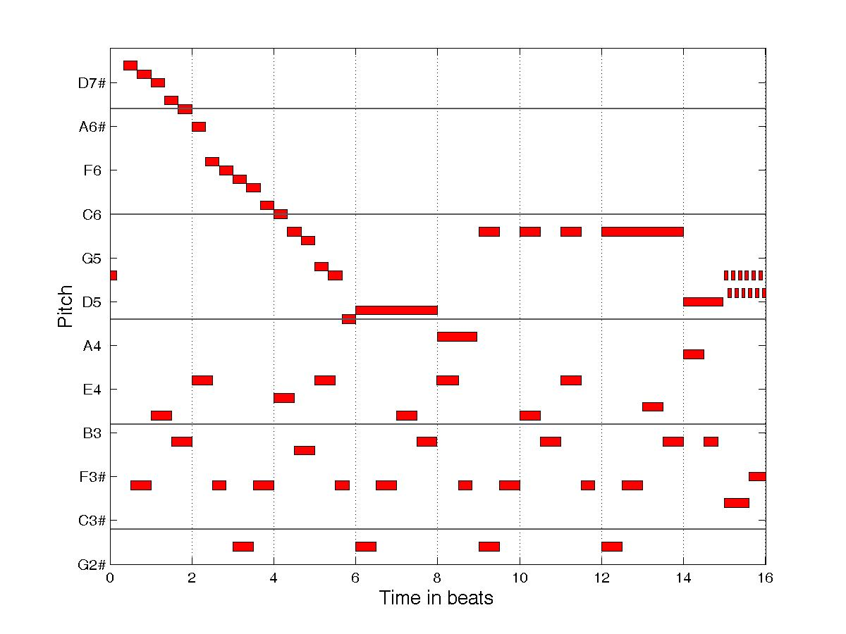
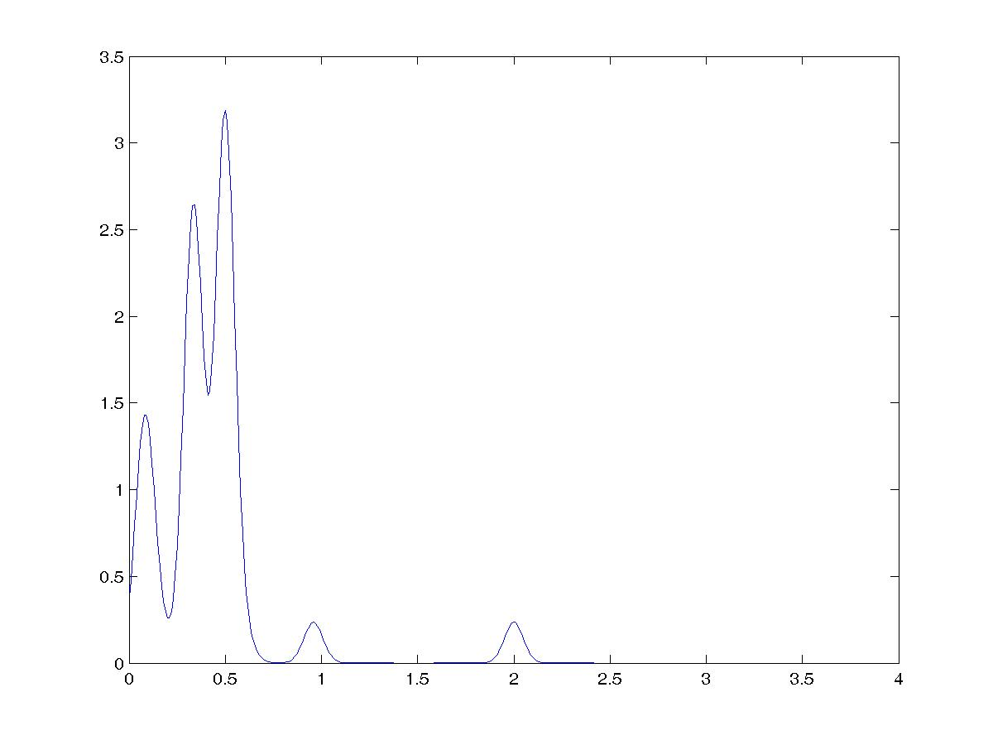
Piano score classification system (5/8)
Descriptor 3: Note length distribution
  Progressive definition scale wich reduce #dimensions but keeps definition on short notes
  31 dimensions from 1/8 beat to 4 beats

Slide 26
Piano score classification system (6/8)
Descriptor 4: Number of notes
  Note event « density » of the fragment
  Only one dimension

Slide 27
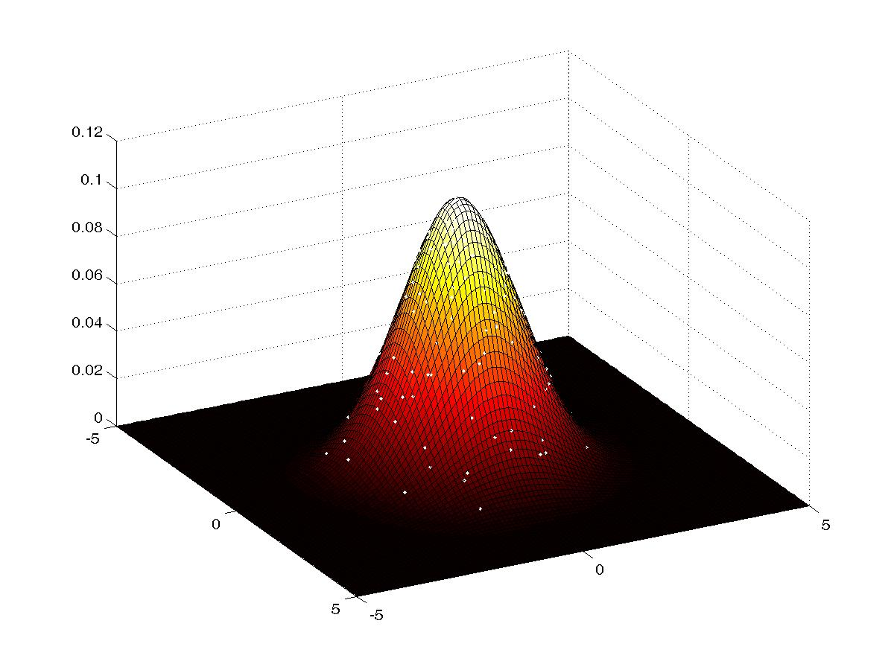
Piano score classification system (7/8)
Requires a 69 dimension dot (i.e. fragment) cloud comparator
Relative entropy kernel based on density estimation

Slide 28
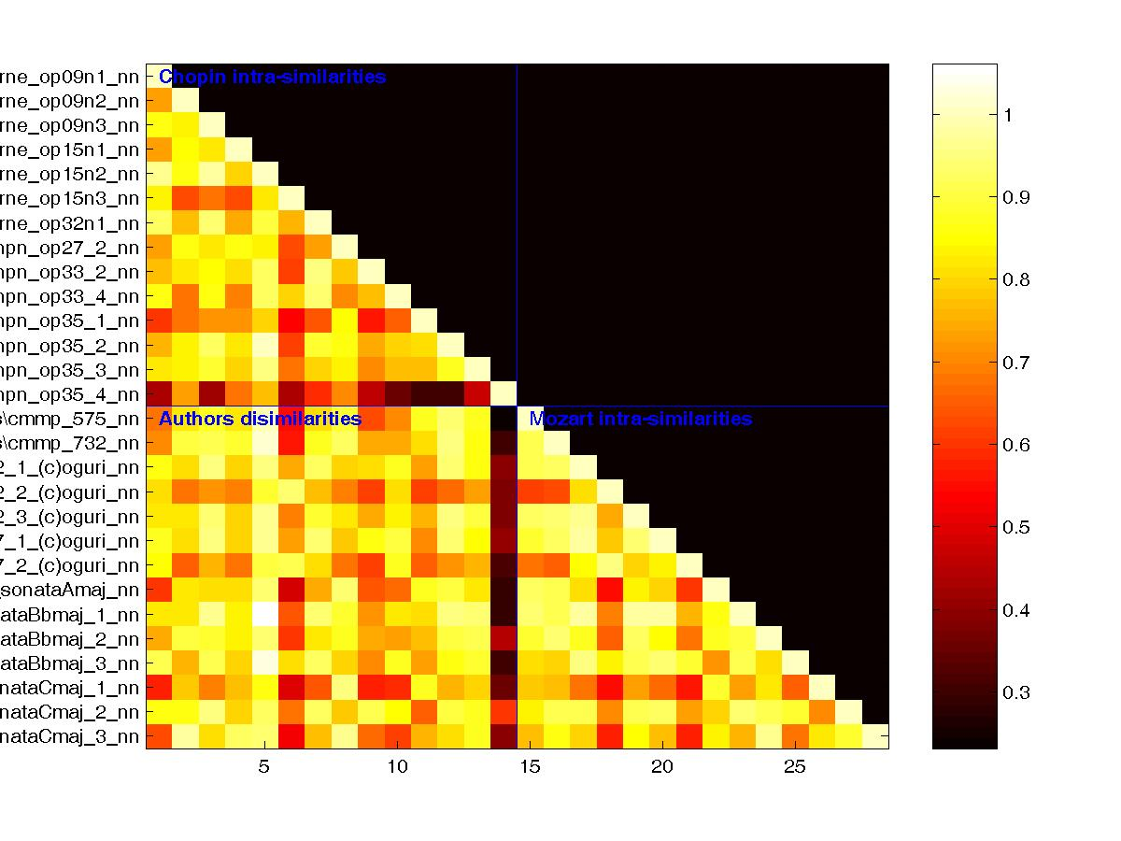
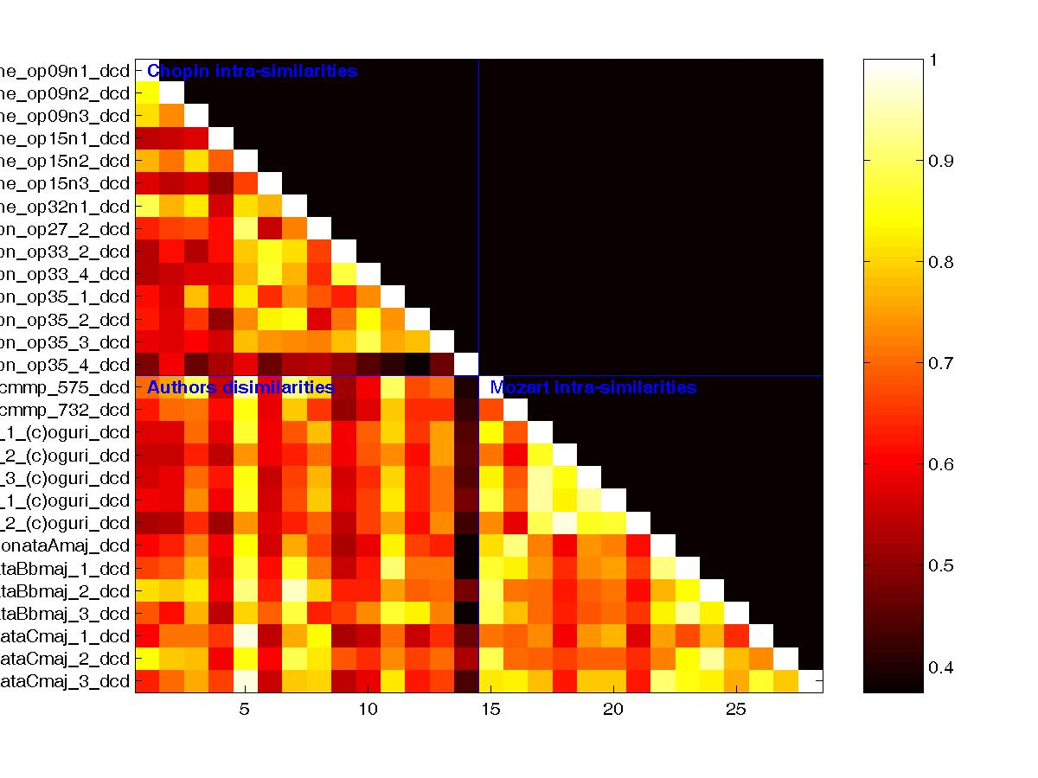
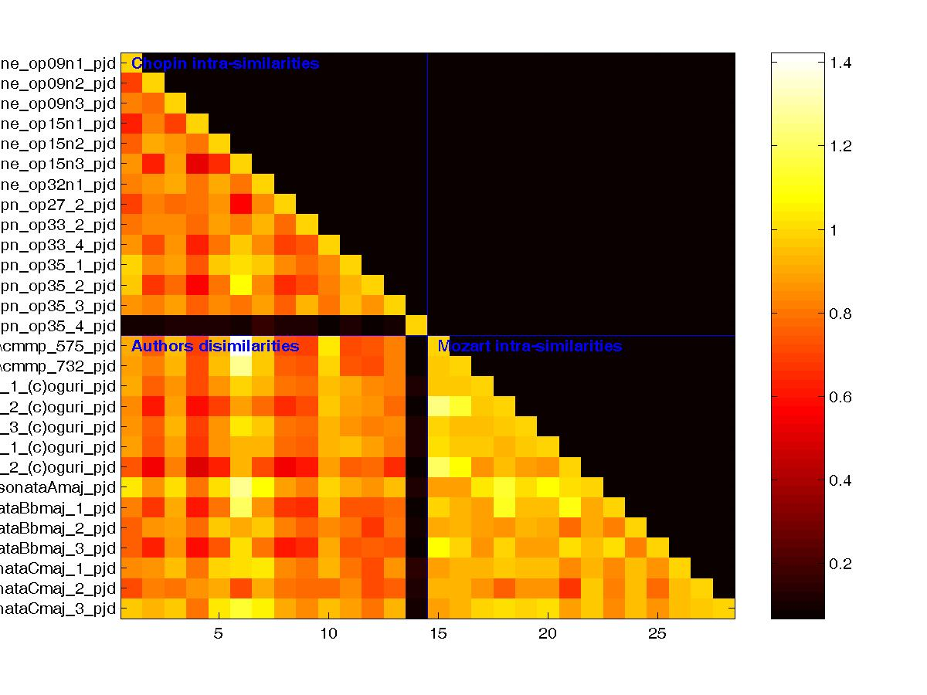
Piano score classification system (8/8)
Similarity measure fails
Too few samples (20 songs) w.r.t. # dimensions
Should consider PCA
Should gather all descriptors in one model

Slide 29
Motivations
Improve my IT skills
Wish to improve my english

